Slide 1
Maintaining Appropriate Student Behavior

Slide 2
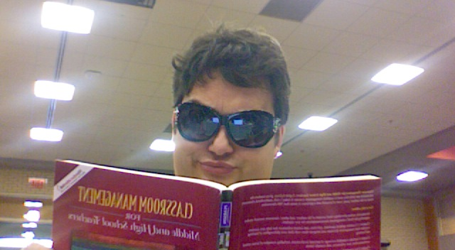
How to monitor student behavior- Mr. Aaron Tinnin

Slide 3
Monitoring Student Behavior
Two important categories of behavior
1. Student involvement in learning activities.
(attention during presentations & discussions, progress on seatwork)
2. Student compliance with classroom rules and procedures.
***Key- MUST have a clear set of expectations (CEP)

Slide 4
Monitoring Student Behavior
Effective monitoring techniques
-be able to see the faces of all students
-scan the room frequently
-monitor the class by walking around and checking individual student’s progress
-don’t “talk to the chalkboard”
-begin seatwork as a whole group activity
-monitor students’ grades and have them keep records

Slide 5
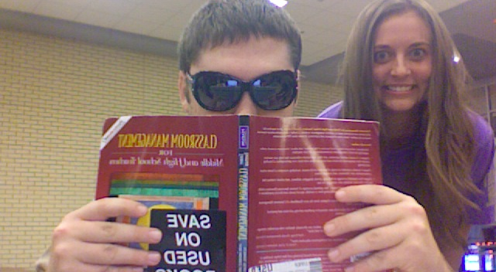
How to be consistent- Mr. Matt Joyner

Slide 6
Consistency
What is consistency?
Maintaining the same expectations for behaviors that are appropriate or inappropriate in particular activities.
- Applicable to all students in every situation, no exceptions should be made
- Inconsistency can lead to students testing the boundaries and behaving inappropriately

Slide 7
Consistency
Ex. If the penalty for tardiness is a detention, then the rule must be enforced all the time.
However, there are exceptions….
Some students have particular individualized programs that need to be followed
Utilize good judgment when it comes to extending deadlines
Talking during group work and seatwork
-maintain and discuss rules and guidelines for student talk

Slide 8
Consistency
Undesirable inconsistency usually arises from
Procedures or rules are not reasonable, workable, or appropriate
Teacher fails to monitor behavior
Teacher is not consistent with enforcing penalties
Ways to address inconstancy
re-teach procedure, modify and reintroduce it, or abandon it if it doesn’t work.

Slide 9
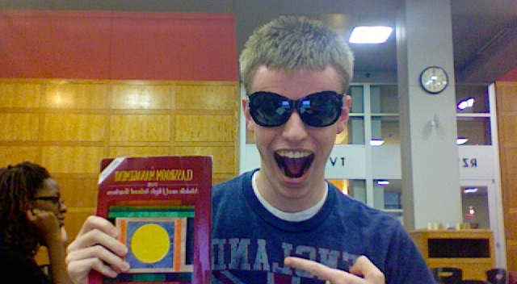
How to manage inappropriate behavior- Mr. Tyler McBride

Slide 10
Prompt Management of Inappropriate Behavior
Prompt management helps prevent escalation
Areas of concern include: lack of involvement, work avoidance, obvious violations of classroom rules and procedures
“withitness” – detect off task behavior and stop it before it happens
Do not ignore off task behavior, address it directly and calmly

Slide 11
Prompt Management of Inappropriate Behavior
Four Ways To Manage Inappropriate Behavior
Proximity- make eye contact, move closer to the student, use a signal (such as finger to the lips)
2. Simply remind the student/class of the appropriate procedure
3. When a student is off task, redirect his/her attention to the task
4. Ask or tell the student to stop the inappropriate behavior. Then, monitor until it stops.

Slide 12
Prompt Management of Inappropriate Behavior
-If you are unable to address the student about his/her behavior at the time, discuss it privately with him/her later
-Send student to the hall or to a time-out desk if they are being disruptive

Slide 13
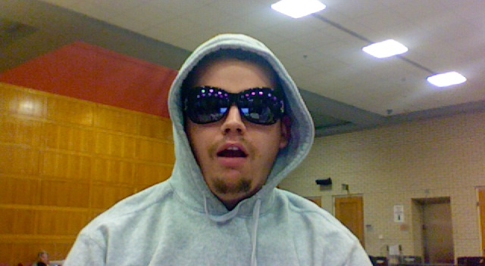
How to build a positive climate- Mr. Jeff Ayers

Slide 14
Building A Positive Climate
Keep a positive perspective and avoiding dwelling on student misbehavior or inadequacies
Students need specific corrective feedback to know what to improve (avoid negative comments!)
Students should look forward to class, expect to learn and receive assistance , and feel supported in their efforts.
If you believe your students are capable they are more likely to work harder
Praise student accomplishment

Slide 15
How to build a positive climate
Discuss instructional goals
Insist students complete work satisfactory
Refuse to accept excuses for poor work
Communicate acceptance of imperfect initial performance when students struggle to achieve new learning
Convey confidence in students’ abilities
Avoid comparative evaluations
Display an encouraging “Can Do” attitude that generates student self-confidence

Slide 16
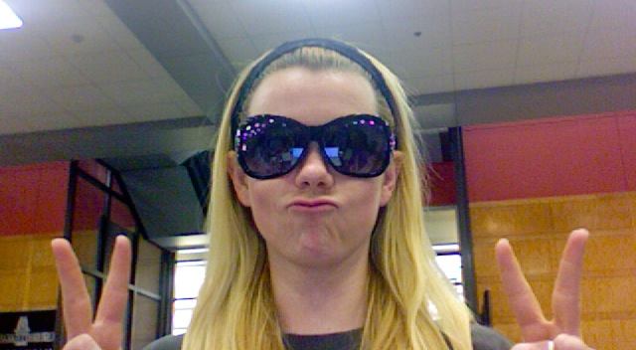
Rewards and Incentives- Ms. Candice Duncan

Slide 17
Improving Class Climate Through Incentive or Rewards
Incentives or rewards can help build a positive climate
The incentives add interest or excitement to the class routine while directing attention toward appropriate behavior and away from inappropriate behavior.
When rewarded and not punished, students are more likely to respond positively to the teacher.
Before using incentives, check your school’s policy.

Slide 18
Improving Class Climate Through Incentive or Rewards
Rewards should target behaviors you want to encourage
Have simple procedures for incentives
Make sure all students are able to achieve the incentive
Types of incentives:
  Symbols: grades, gold star
  Recognition: giving attention to the student, displaying work
  Activities: free time, work with a friend, class party or trip
  Materials: awarding objects of value to students
CAUTION: receiving a reward reduces intrinsic motivation to complete a task if extrinsic reward is no longer available
Verbal praise and positive feedback help enhance student’s intrinsic motivation

Slide 19
A big thank you to Mrs. Rachael Pavey who created this wonderful PowerPoint. She more than contributed her part!

Slide 20
Group Activity
At your table, develop a skit that is either a good representation or a bad representation of the topic on your group’s index card.
You have 5 minutes to create a skit that should be about 1 minute long.
You will present these to the class for a formative assessment!

